Slide 1
WAVELET TRANSFORM

Slide 2
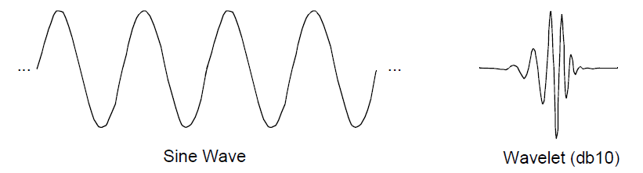
Wavelet Analysis(contd.)
Fourier analysis: Breaking up a signal into sine waves of various frequencies
Wavelet analysis: Breaking up of a signal into shifted and scaled versions of the original (or mother) wavelet

Slide 3
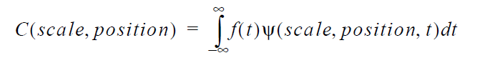
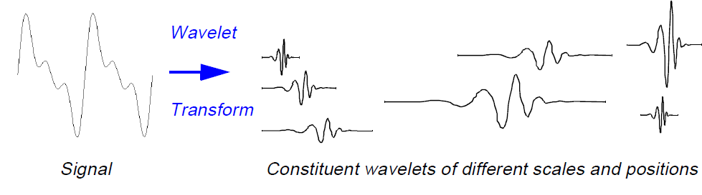
Wavelet Analysis:
Notes:
https://web.iitd.ac.in/~sumeet/WaveletTutorial.pdf

Slide 4
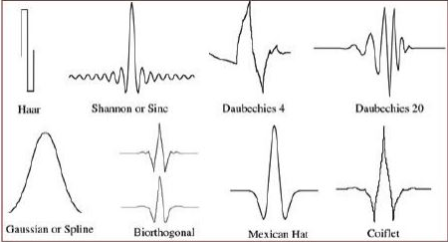
Types of Wavelets
Haar
Daubechies
Biorthogonal
Coiflets
Symlets
Morlet
Mexican Hat

Slide 5
Work Done (So far)
Base line wandering was removed using Wavelet transform. Wavelet Toolbox available in Matlab was used. Daubechies (dB5) wavelet as mother wavelet. Scale level used was 7
RR peaks was then detected on the filtered signal
Frequency domain features were extracted
De-trending the signal and RR peak detection was also implemented on Python

Slide 6
Features Extracted(Frequency domain)
Peak Frequency for VLF,LF and HF range
Absolute power of VLF,LF and HF bands
Relative power of each band
Normalized power of LF and HF band
Ratio between LF and HF band powers

Slide 7
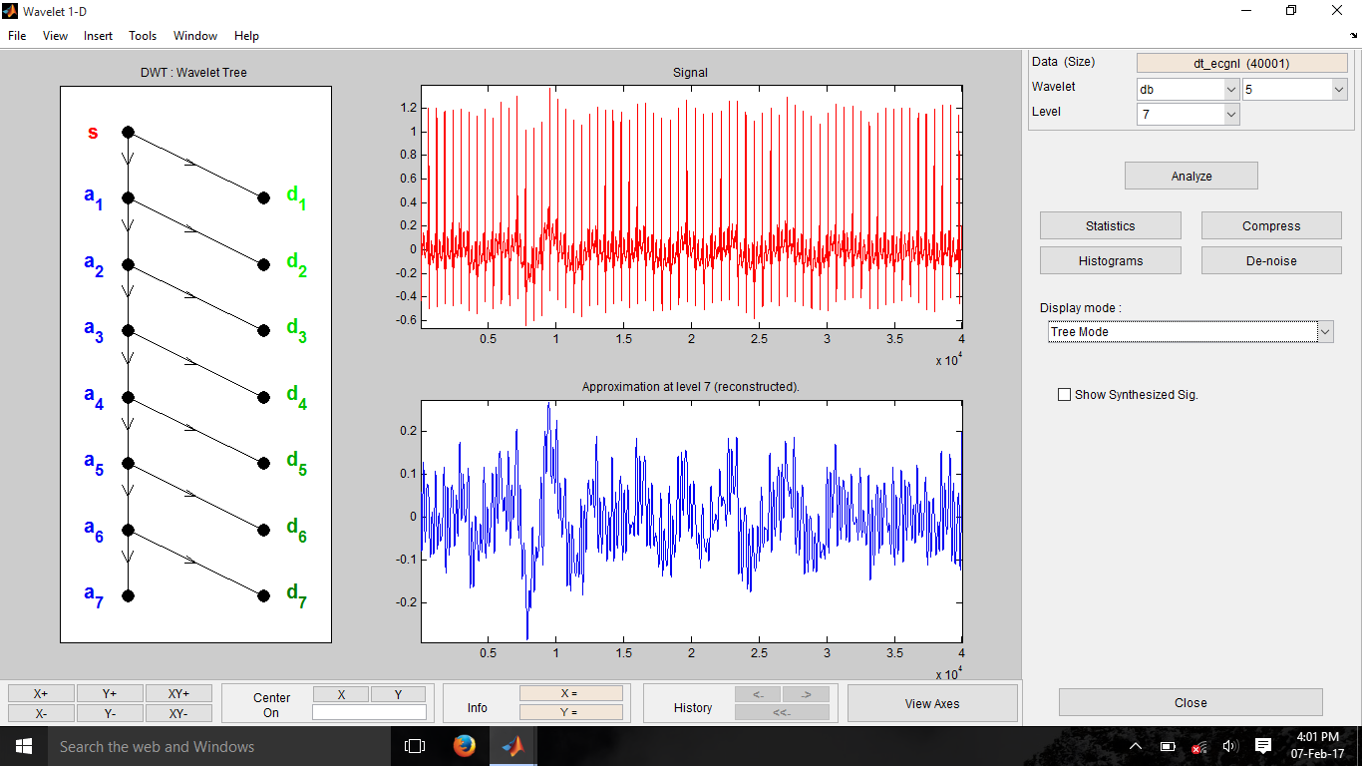
Graphs (Wavelet Toolbox-Matlab)

Slide 8
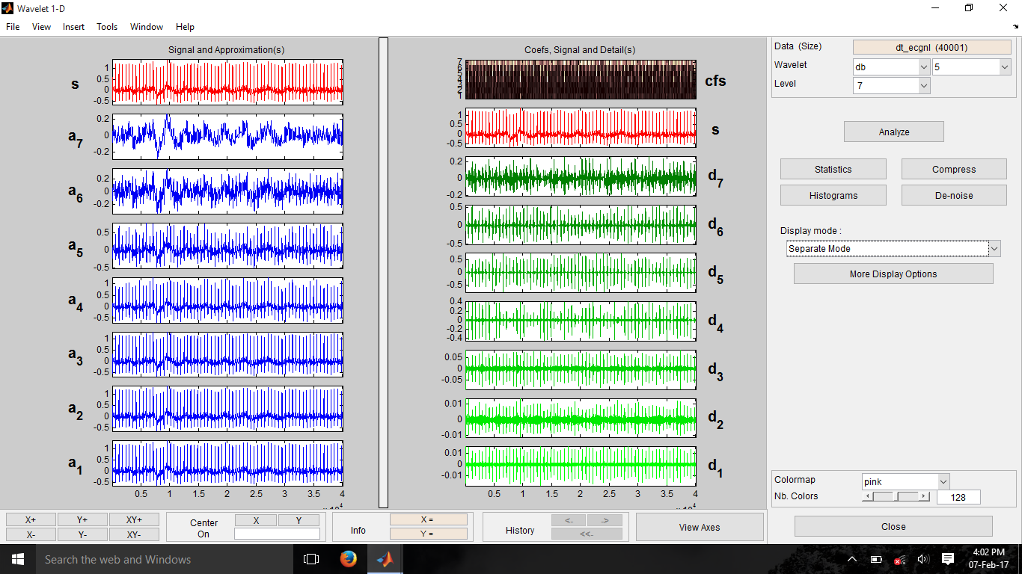

Slide 9
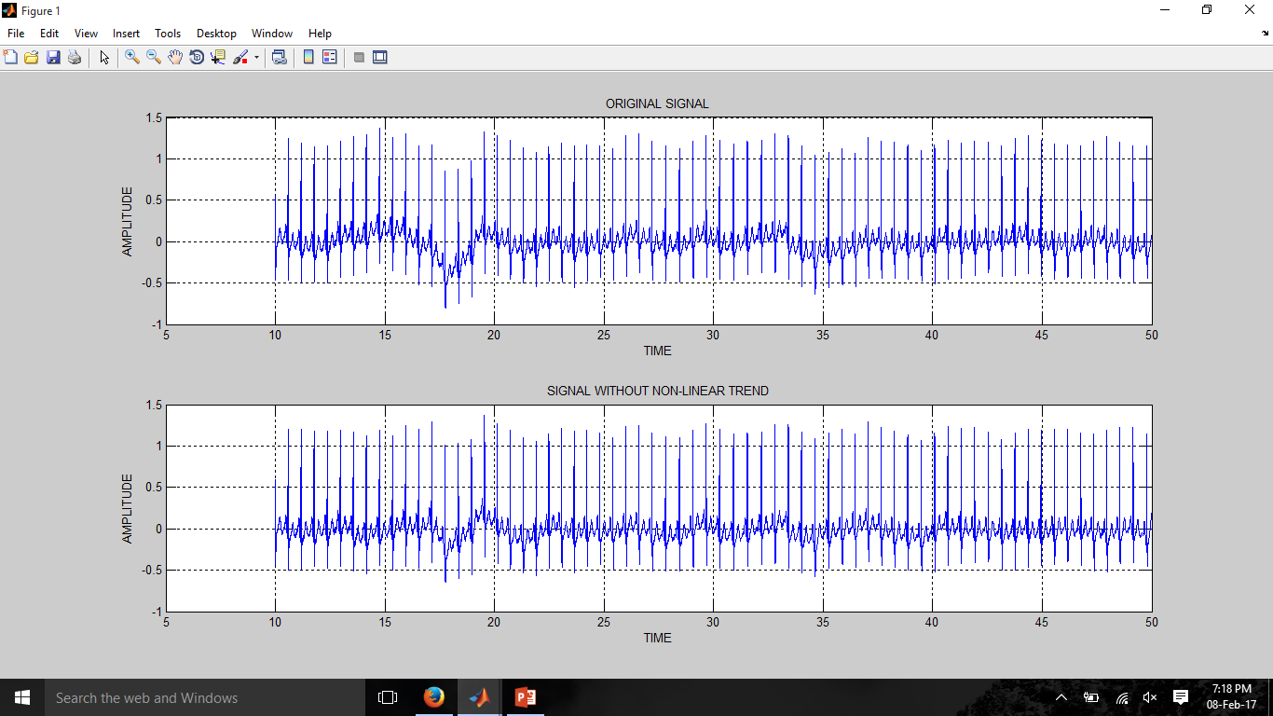
Graphs [Matlab]

Slide 10
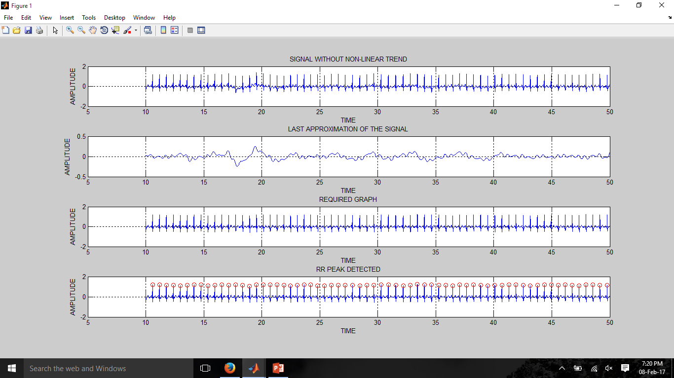

Slide 11
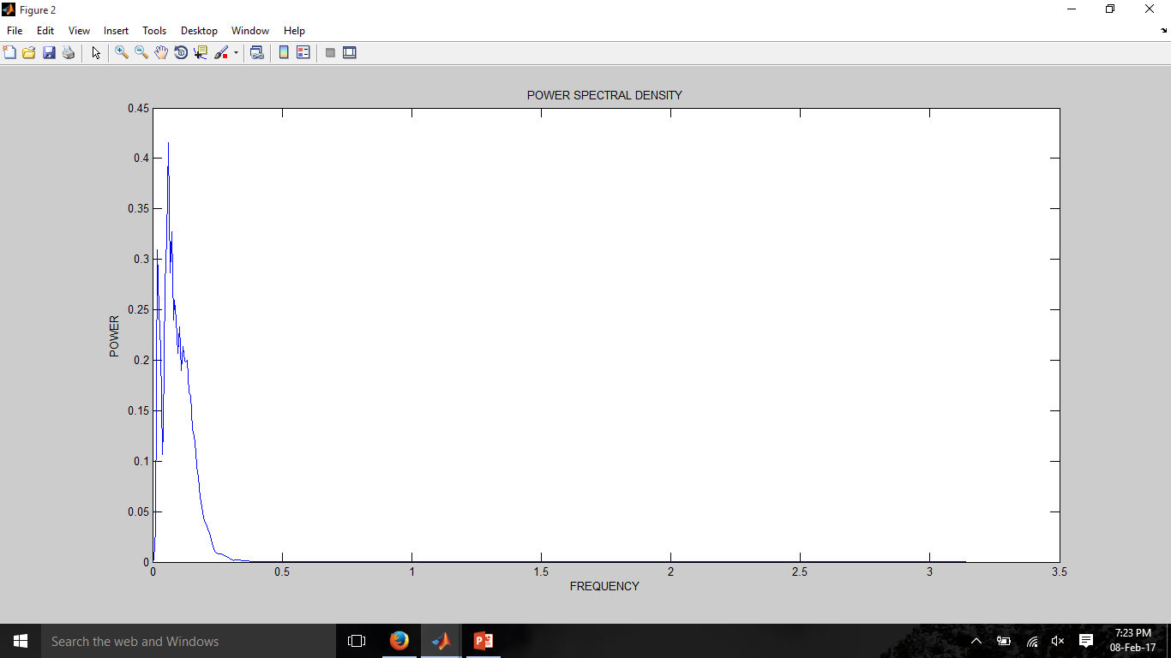
POWER SPECTRAL DENSITY

Slide 12
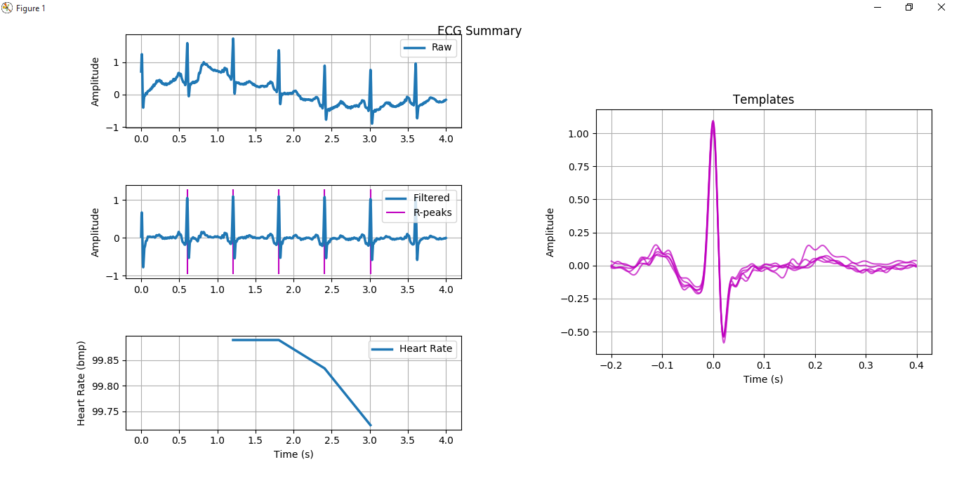
Graph(Python)
Notes:
Module used : biosppy,numpy and matplotlib

Slide 13
Next review targets
Use command line instruction in Matlab script to remove the dependence on toolbox for isolation of scaled signal
Consolidate the data for all the samples available into a csv file
Use the wavelet analysis module instead of biosppy in python
Port the Matlab code to Raspberry-Pi

